Slide 1
Feature Importance and Model Interpretability
Raden Muhammad Hadi

Slide 2













Mentor Profile
Professional Career
Principal Data Scientist @ DELOS (Now)
Data Science Consultant @ StatsMaster (Now)
Data Science Mentor @ Several Ed-Tech Companies (Now)
Dibimbing.id
DQLab
Narasio Data
Digital Talent Scholarship
Praktisi Mengajar
Senior Data Scientist @ DELOS
Data Scientist - Financial Service & Digital Products @ Bukalapak
Data Scientist - Growth @ Bukalapak
Head of R&D @ Quantus Telematika Indonesia
Mathematical Modeler @ Quantus Telematika Indonesia
Full-Stack Developer @ Tabel Data Informatika
Raden Muhammad Hadi
Suryo Suharto

Slide 3
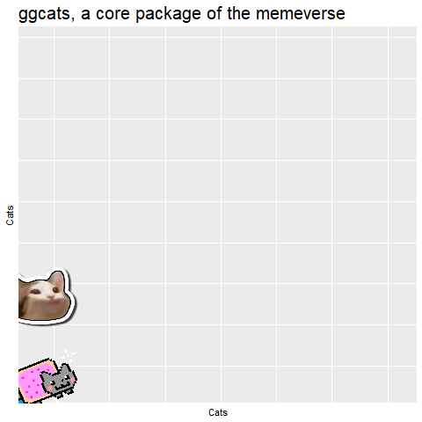
Outlines
Interpretability vs Explainability
Explanatory Model Analysis: Model Agnostic Introduction
Feature Importance: The Most Favourite DS Tools
Partial Dependence Plot
Game Theory-Based Explanation
LIME: Local Interpretable Model-Agnostic Explanation
Notes for Model Interpretation

Slide 4

Before We Start
Python
Link to notebook

Slide 5

Interpretability vs Explainability

Slide 6
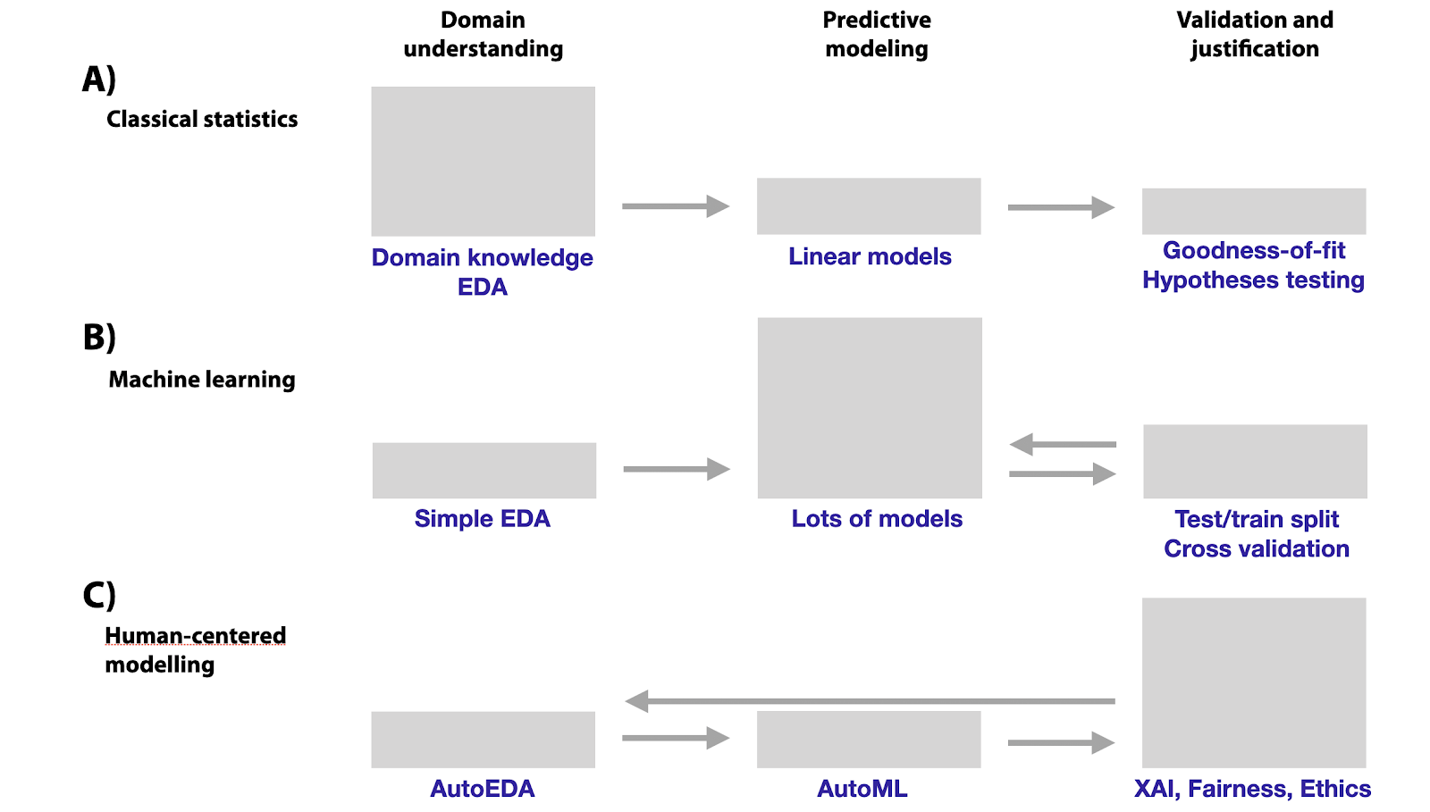
Reference Link: http://ema.drwhy.ai/introduction.html

Slide 7
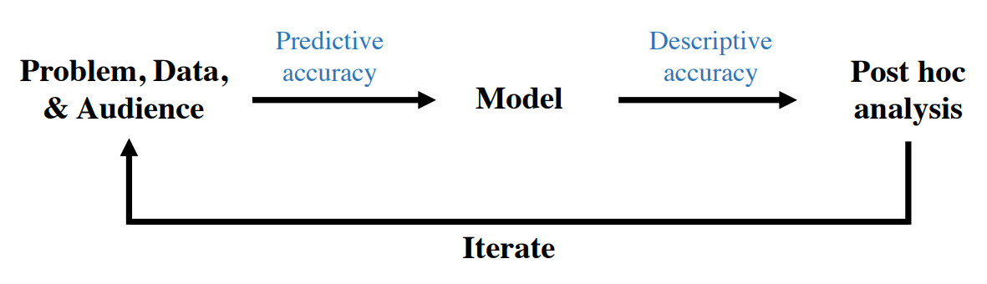
Interpretability in Data Science Process
Reference: https://arxiv.org/pdf/1901.04592.pdf

Slide 8
But, why interpretation and explanation important to machine learning (system)?

Slide 9

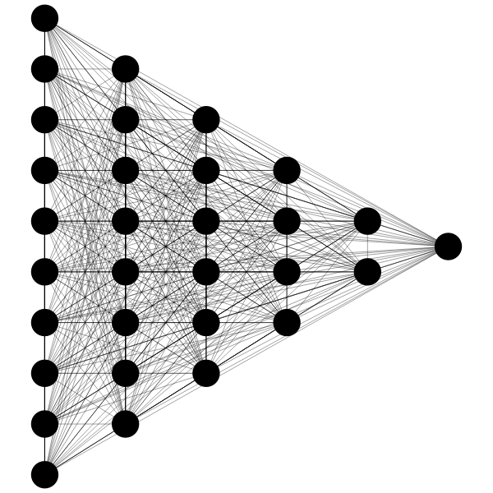


Data Collecting
Model Building
Prediction
Human Action

Slide 10
Data Collecting
Model Building
Prediction
Human Action

Slide 11
Human Biases in Data
Reporting bias
Selection bias
Overgeneralization
Out-Group Homogeneity bias
Stereotypical bias
Historical unfairness
Implicit association
Implicit Stereotypes
Prejudice
Group attribution error
Halo effect
Human Bias in Collection and Annotation
Data Collecting
Sampling error
Non-sampling error
Insensitivity to sample size
Correspondence bias
In-group bias
Bias blind spot
Confirmation bias
Subjective validation
Experimenter bias
Choice-supportive bias
Neglect of probability
Anecdotal fallacy
Illusion of validity

Slide 12
Bias
Bias
Bias
Bias
Data Collecting
Model Building
Prediction
Human Action
Bias Network Effect

Slide 13
The impact?

Slide 14
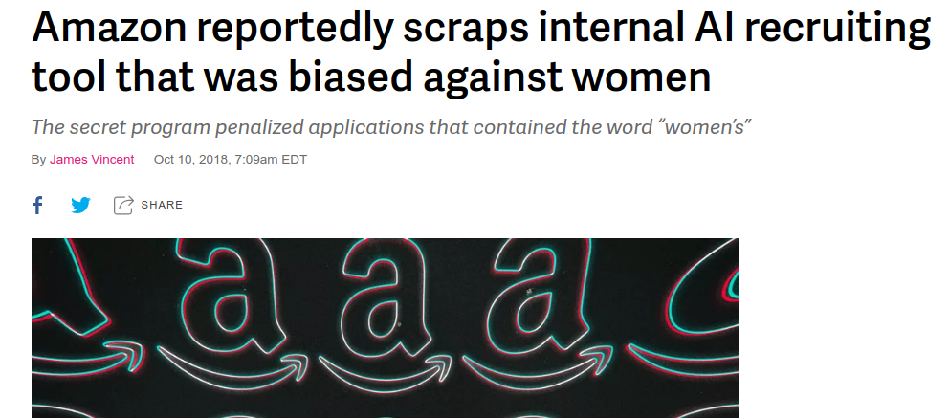
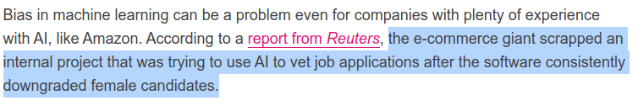
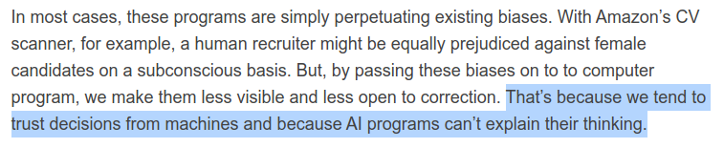
https://www.theverge.com/2018/10/10/17958784/ai-recruiting-tool-bias-amazon-report

Slide 15
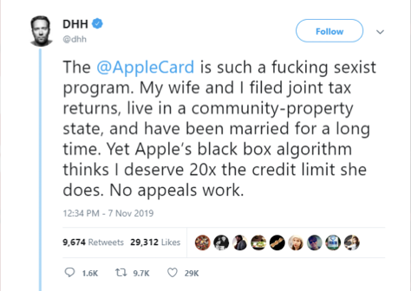
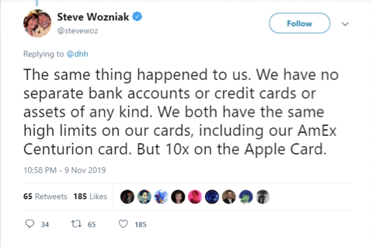
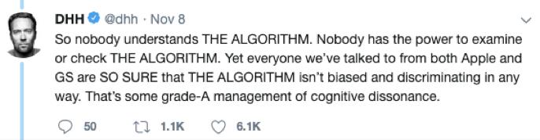
AppleCard Case
https://www.independent.co.uk/life-style/apple-credit-card-sexist-twitter-steve-wozniak-complaints-gender-discrimination-a9197826.html

Slide 16
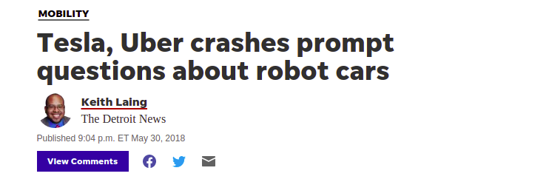
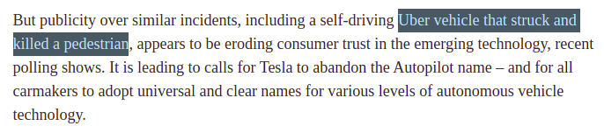
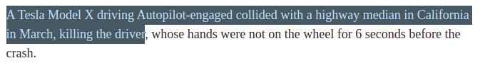
https://www.detroitnews.com/story/business/autos/mobility/2018/05/30/tesla-uber-crashes-prompt-questions-robot-cars/645500002/

Slide 17
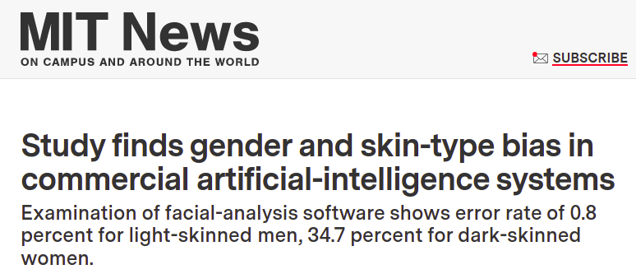
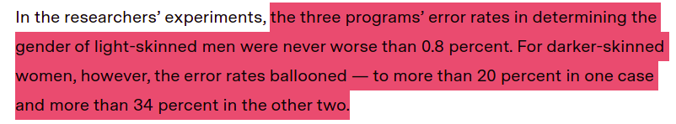
https://news.mit.edu/2018/study-finds-gender-skin-type-bias-artificial-intelligence-systems-0212

Slide 18
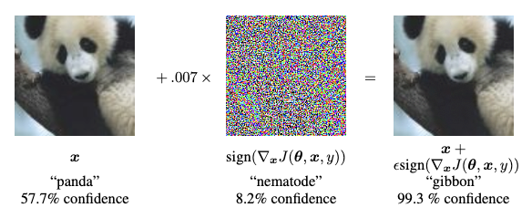
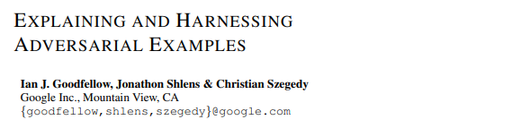
https://arxiv.org/pdf/1412.6572.pdf

Slide 19
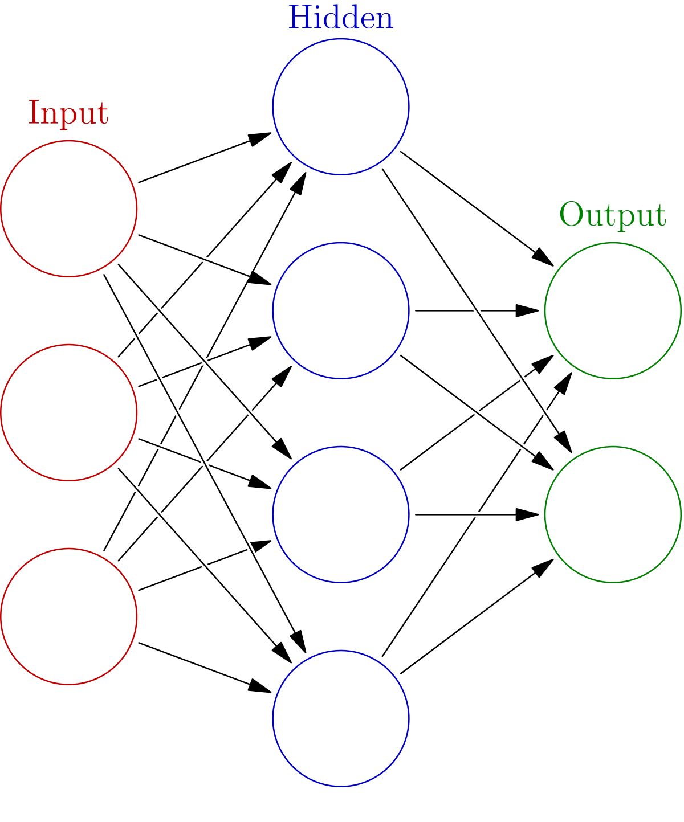


OVARIAN CANCER
“We need to remove your wombs”

Slide 20
Interpretability (in Context of Machine Learning)
“The ability of to explain or to presents in understandable terms to human.”
“Towards a Rigorous Science of Interpretable Machine Learning” by Doshi-Velez and Kim
https://arxiv.org/pdf/1702.08608.pdf

Slide 21
Explanation
“Explainability is associated with the notion of explanation as an interface between humans and a decision maker that is, both an accurate proxy of the decision maker and comprehensible to humans.”
R. Guidotti, et al - “A Survey of Methods for Explaining Black Box Models” (2018)

Slide 22
Interpretability vs Explainability
Interpretability: the ability of the model to speak about their self
Explainability: how you represent the model so it can explain its reasons to certain audience.

Slide 23
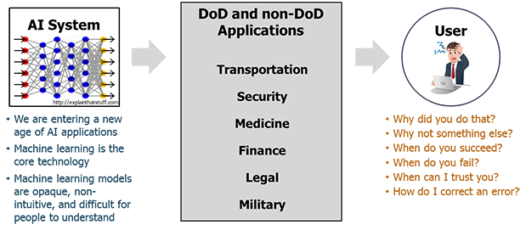

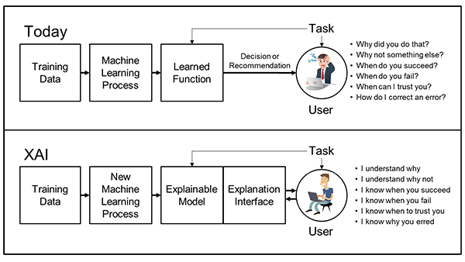
DARPA XAI Programs
Source: https://www.darpa.mil/program/explainable-artificial-intelligence

Slide 24




Machine Learning
Inform
Learn
Capture
Human
Model
Data
The World

Slide 25

Machine Learning
+
XAI
Inform
Extract
Learn
Capture
Human
XAI
Model
Data
The World

Slide 26





“
Debugging
Auditing
Why XAI?
Leveraging
Trusting
“
Examining

Slide 27
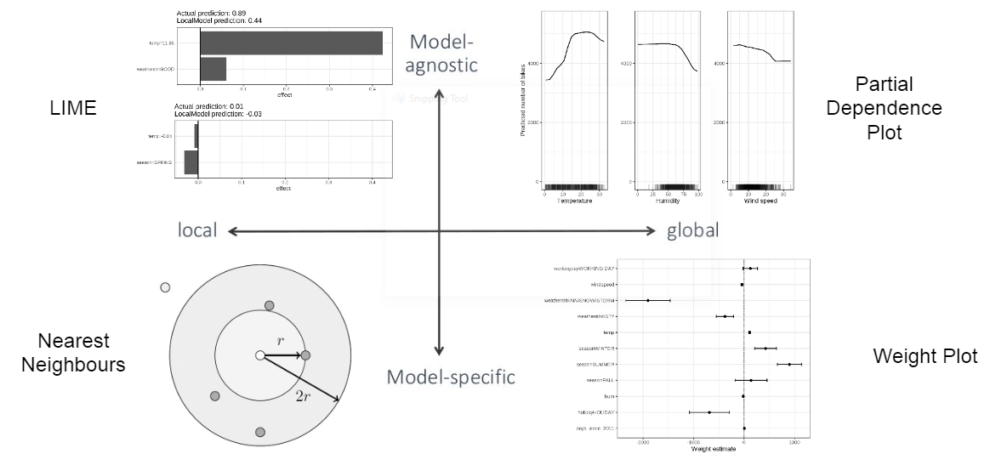
Interpretability Quadrant

Slide 28
Interpretability Quadrant
Now

Slide 29



Model-Agnostic Explanation
Model-agnostic explanation are model explanation method that can be used to nearly all kind of machine learning models
Example of model-agnostic methods:
Permutation Feature Importance
Partial Dependence
Shapley Value
Surrogates Model
Local Interpretable Model Explanation

Slide 30
Feature Importance: The Most Favourite DS Tools

Slide 31

Wait, “Permutation Feature Importance”? What make it difference with other feature importance methods?

Slide 32
Impurity
Permutation
Type of Feature Importance
Tree-based only
Model-Agnostics
LOCO
Attribution
Model-Agnostics
Model-Agnostics, Local & Global

Slide 33
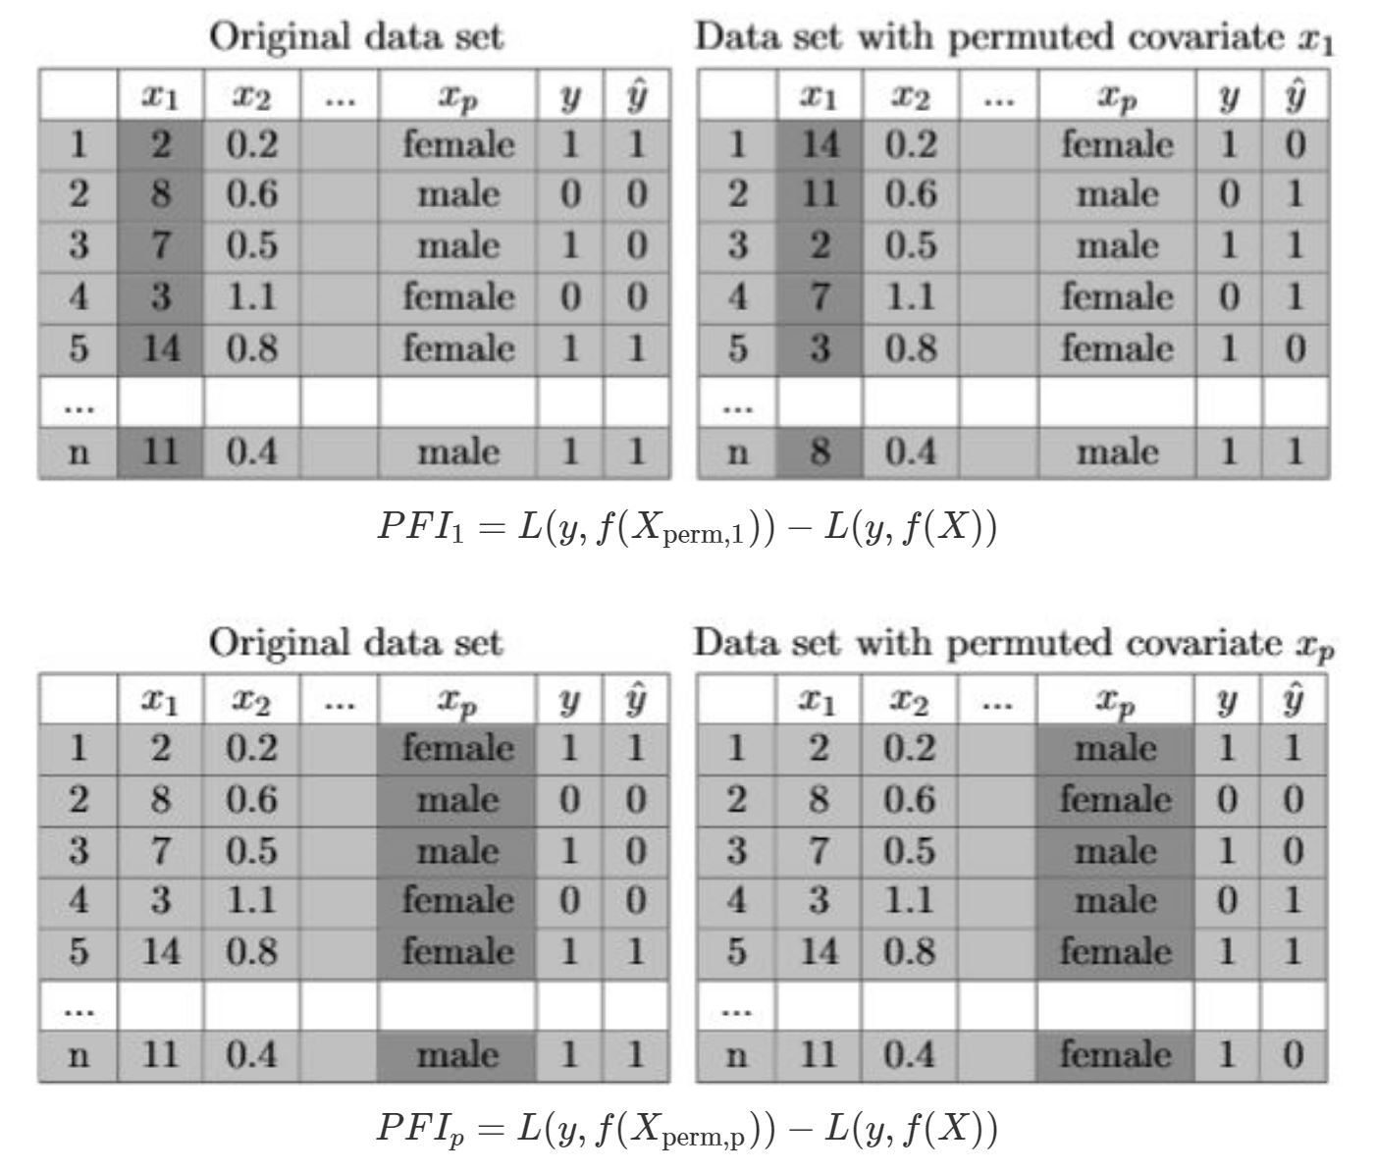
Permutation Feature Importance
Permute the values of certain feature, then measure its importance based on prediction error.

Slide 34
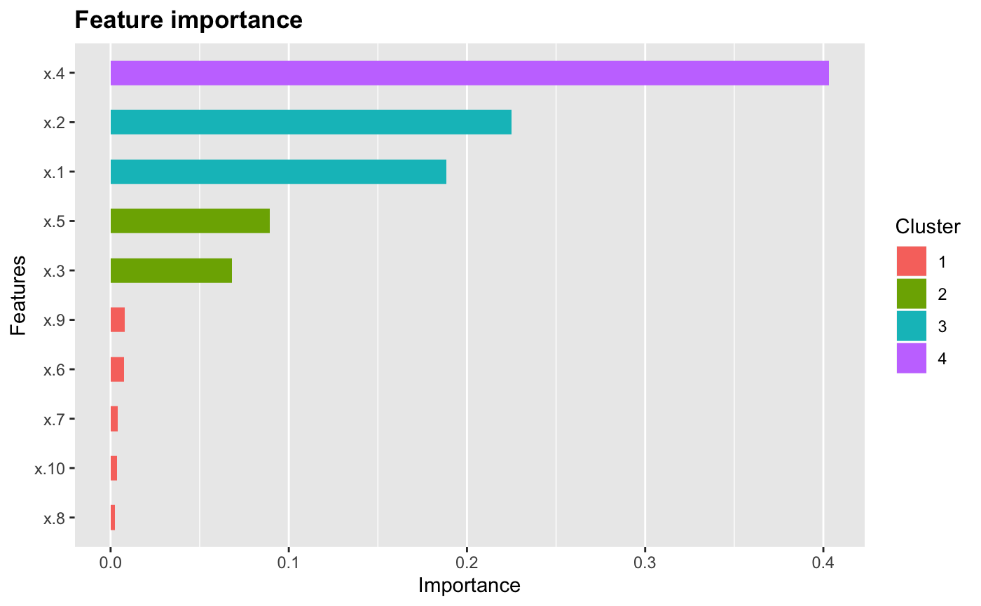
Permutation Feature Importance
Less Impact
Great Impact

Slide 35
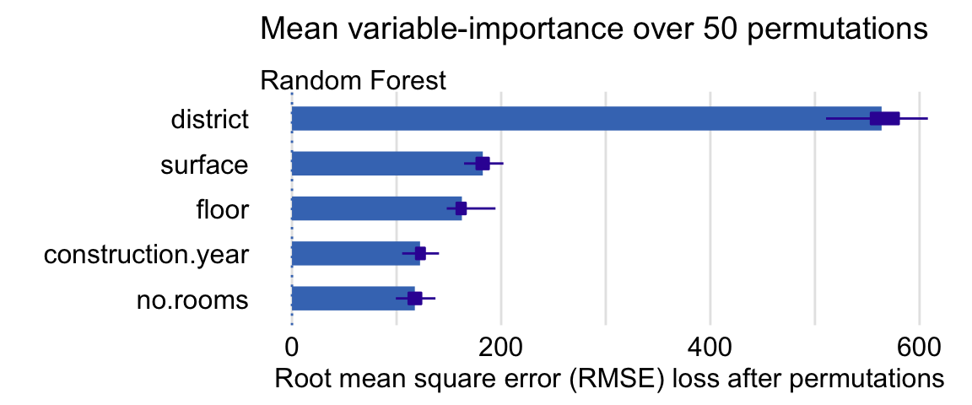
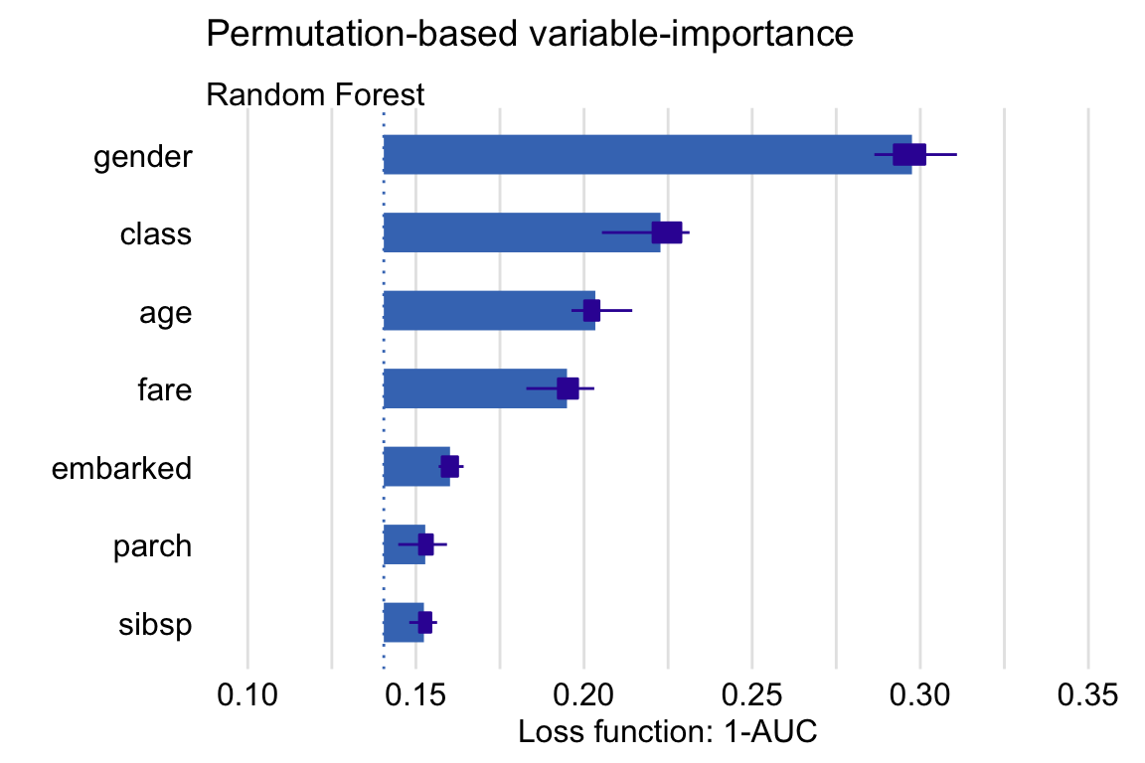
Permutation Feature Importance: Visualization
Regression
Error or Loss
Classification

Slide 36
Takes into account all interactions
No direction on feature effects
Does not require retraining the model
Dependence on randomness
Pro
Cons

Slide 37
Let’s Try!

Slide 38
Partial Dependence Plot: Explain Variable Dependence

Slide 39
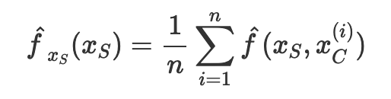
Partial Dependence
Estimated by averaging predictions with actual feature values of x_{c} in the training data at given values of x_{s}
Feature to measure its marginal effect
Other features
Model predicted values based on feature of interest

Slide 40
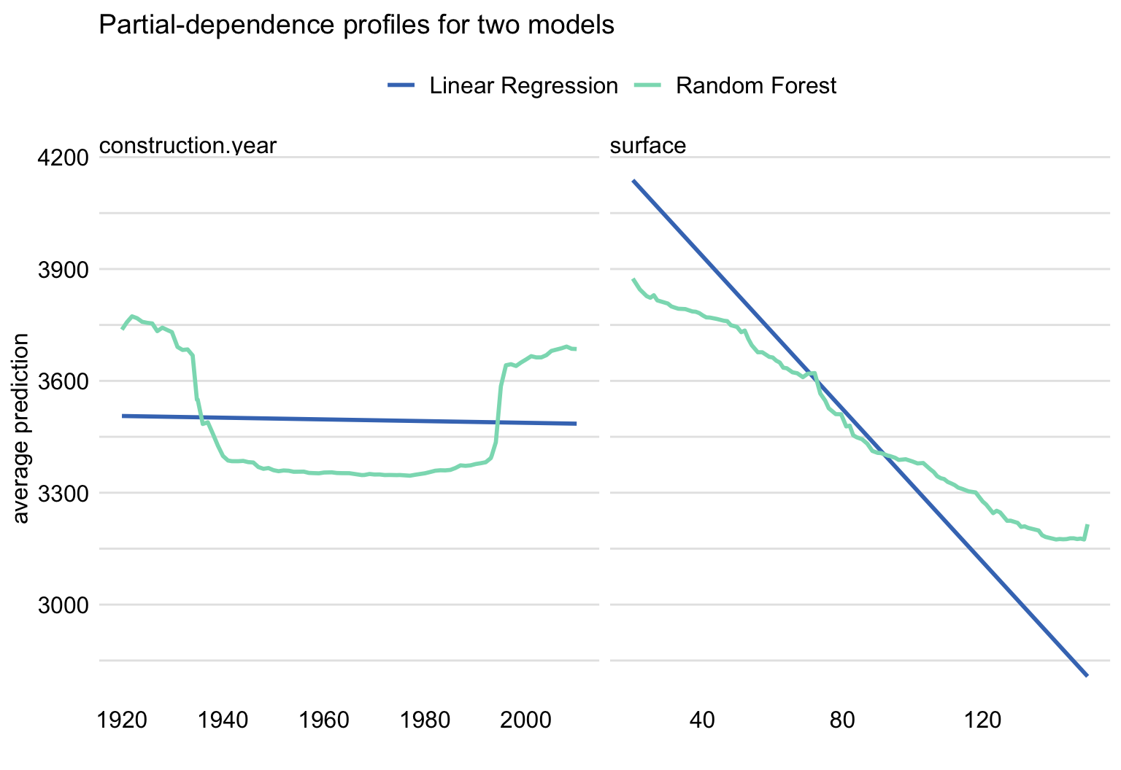
Partial Dependence Plot

Slide 41
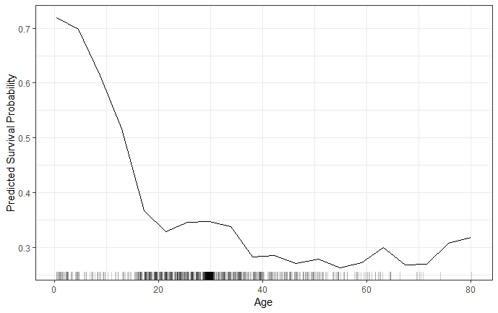
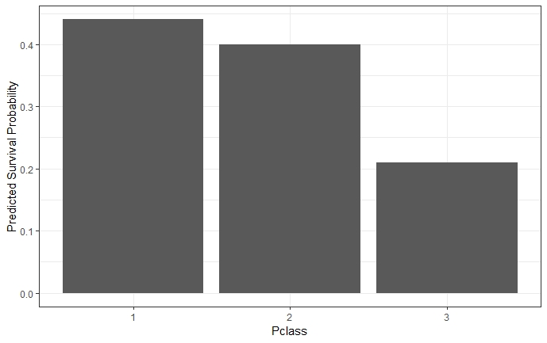
Partial Dependence Plot: Visualization
Numeric Feature
Categorical Feature

Slide 42
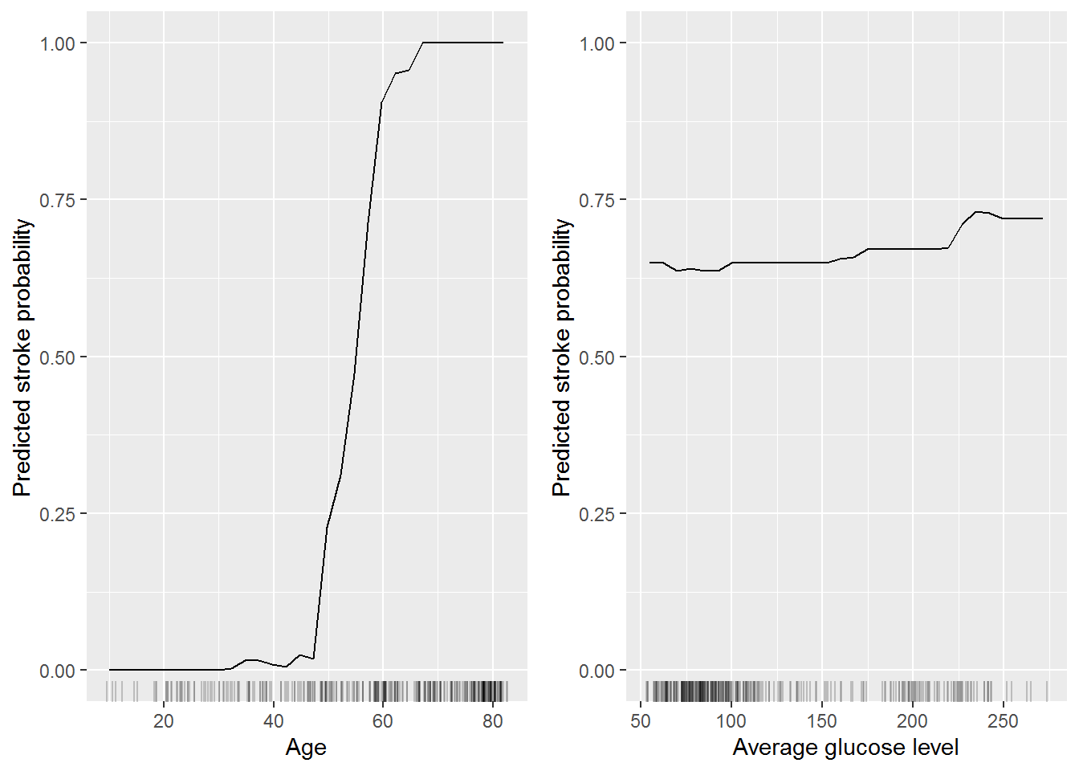
Partial Dependence Plot Example:
Prediction of Stroke Probability Based on Age and Glucose Level
No Impact
No/small Impact
Positive Impact
No Impact
Notes:
Explain the methodology:
ML + IML

Slide 43
Show direction of feature effect to prediction
Only show average marginal effect
Can be used to compare groups
Pro
Cons

Slide 44
Let’s Try!

Slide 45
LIME: Local Interpretable Model-Agnostic Explanation

Slide 46
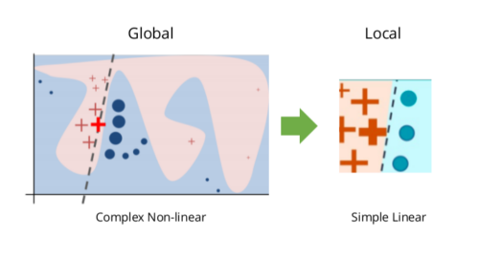
LIME
LIME (sometimes called Local Surrogate Models) are interpretable models that are used to explain individual prediction of black box machine learning models by train surrogate models to approximate the prediction of the underlying black box model

Slide 47
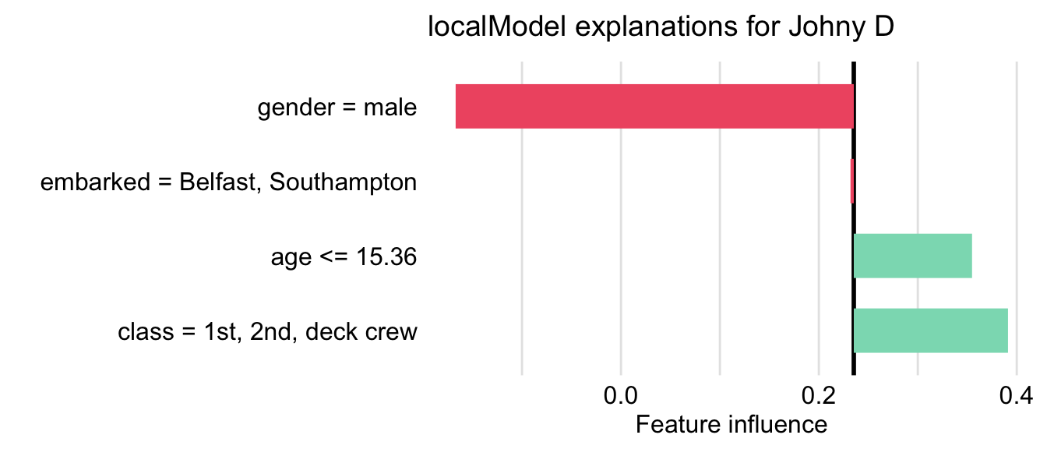
LIME Plot
Negative influence
Positive Influence

Slide 48
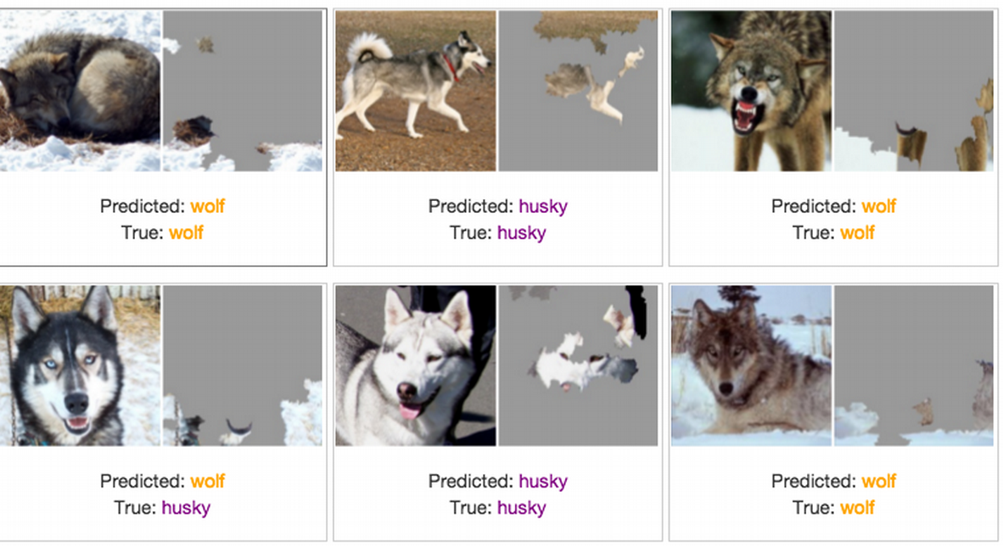
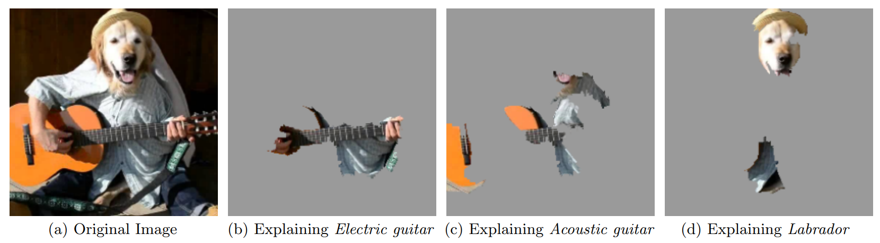
LIME Example:
Using LIME to debug computer vision prediction
Notes:
Explain the methodology:
ML + IML

Slide 49
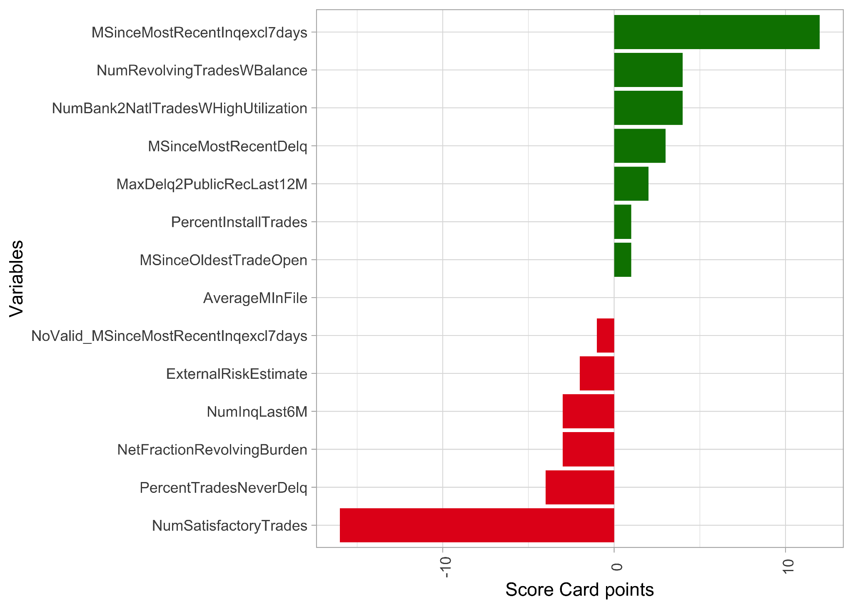
LIME Example:
Using LIME for score card explanation
Notes:
Explain the methodology:
ML + IML

Slide 50
Human-readable explanations
Stochastic
Works with all kinds of data
Can be manipulated
Fidelity measure
Pro
Cons

Slide 51
Game Theory + Machine Learning: Shapley Value

Slide 52
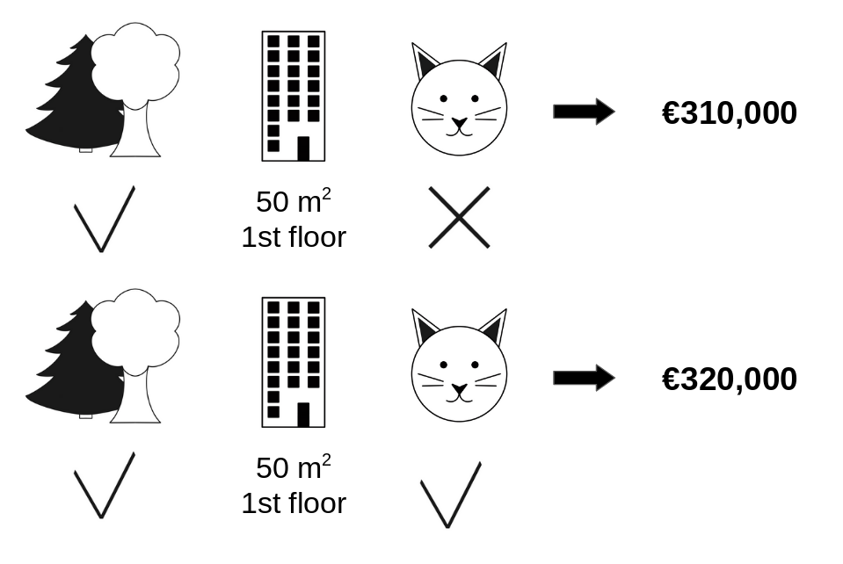
Shapley Value
A prediction can be explained by measuring “fair” feature contribution to model prediction

Slide 53
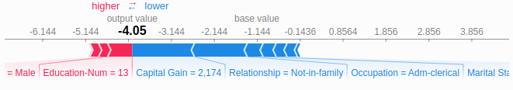
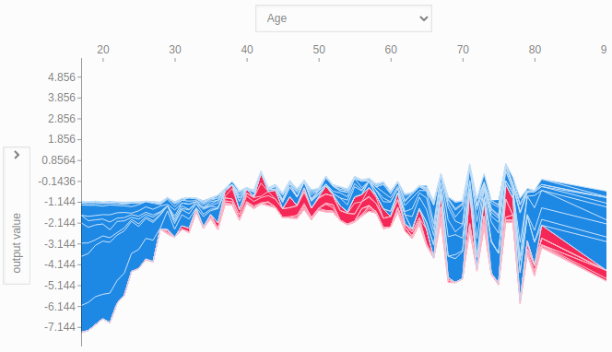
SHAP: Visualization (Instance Level)
Visualize Single Prediction (Force Plot)
Multiple Single Prediction

Slide 54
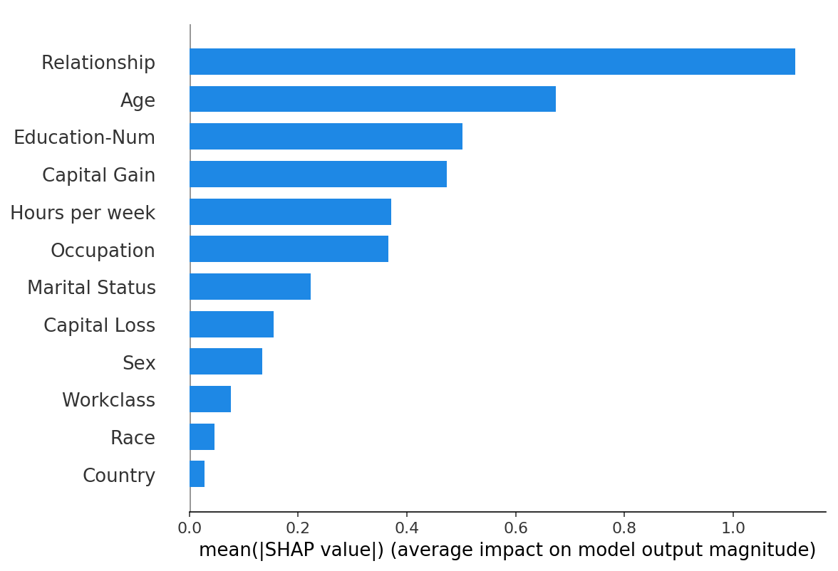
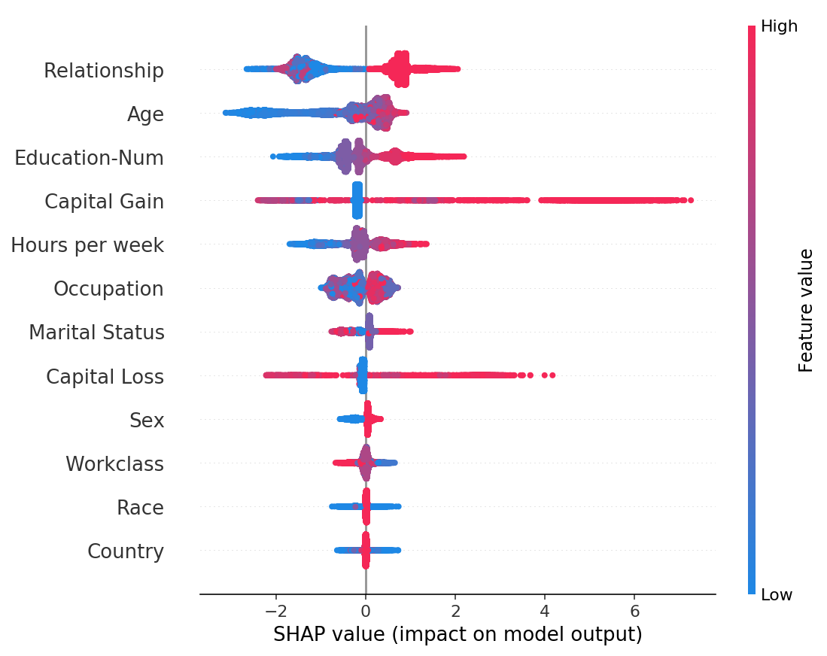
SHAP: Visualization (Dataset Level)
Bar Chart of Mean Importance
SHAP Summary Plot
Less Impact
Great Impact

Slide 55
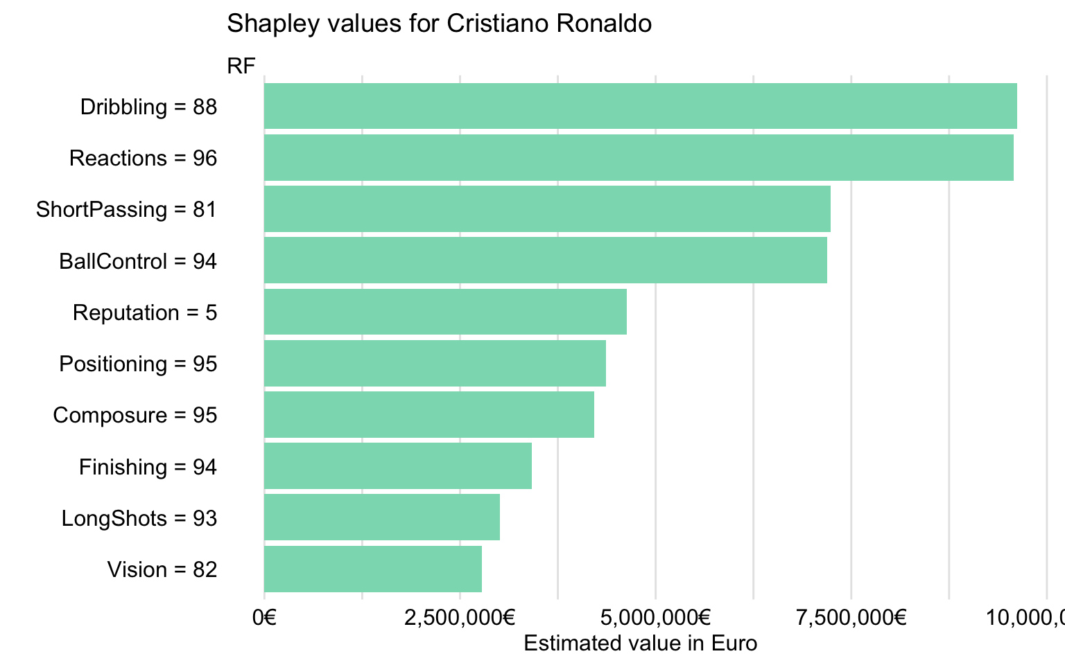
SHAP Example:
Using SHAP to explain player’s value
Notes:
Explain the methodology:
ML + IML

Slide 56
Solid theoretical foundation
Only show average marginal effect
Can be used for local and global interpretation
Lot of computing time
Ignores feature dependence or multiplicative attribution
Can be used on multiple cases
Pro
Cons

Slide 57
Let’s Try!

Slide 58
Notes for Model Interpretation

Slide 59

Interpretable Doesn’t Directly Translate to Truth
Some methods (such as SHAP method) makes correlation transparent, but correlation doesn’t make them causal
To deliver causal results the features need to be independent not only of other features in the model, but also of unobserved confounders

Slide 60

References
Books:
Interpretable Machine Learning with Python by Serg Masis
Hands-On Explainable AI (XAI) with Python by Denis Rothman
An Introduction to Machine Learning Interpretability by Patrick Hall and Navdeep Gill
Online:
Interpretable Machine Learning by Christoph Molnar
Explanatory Model Analysis by Przemyslaw Biecek and Tomasz Burzykowski

Slide 61
Thanks!

